Slide 1
Interest Rate Model - HJM
July 2020

Slide 2
Agenda
HJM Model
HJM Model Implementation

Slide 3
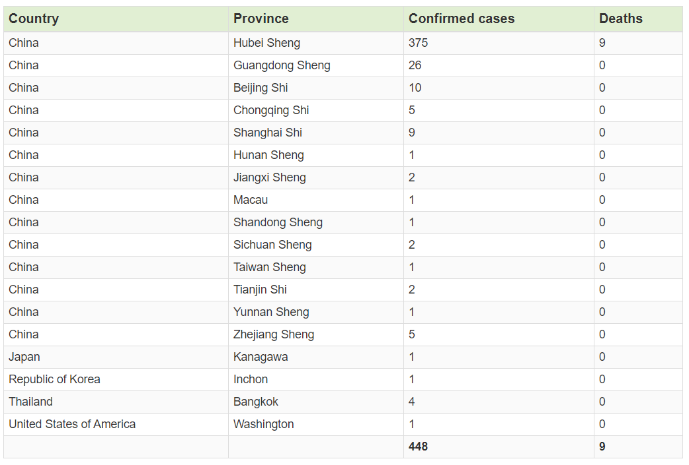
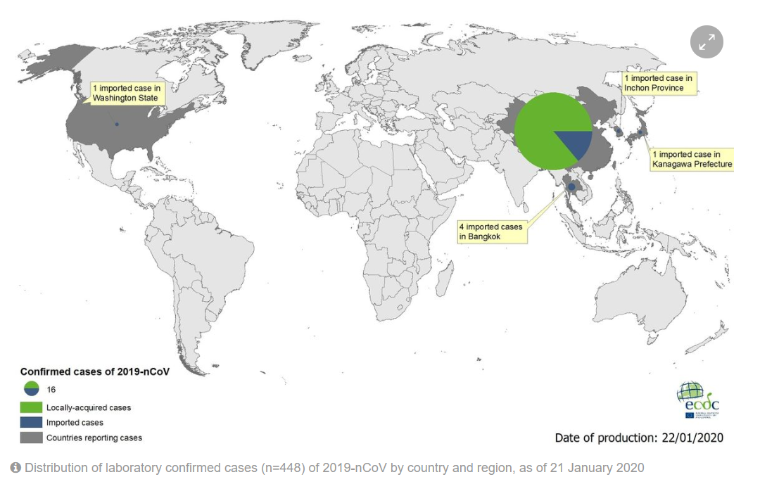
2019 Novel Coronavirus
An outbreak of respiratory illness caused by a novel (new) coronavirus (2019-nCoV)
It was first detected in Wuhan City, Hubei Province, China and it continues to expand
As of 1/21/2020: confirmed 448(441 in China), death 9

Slide 4
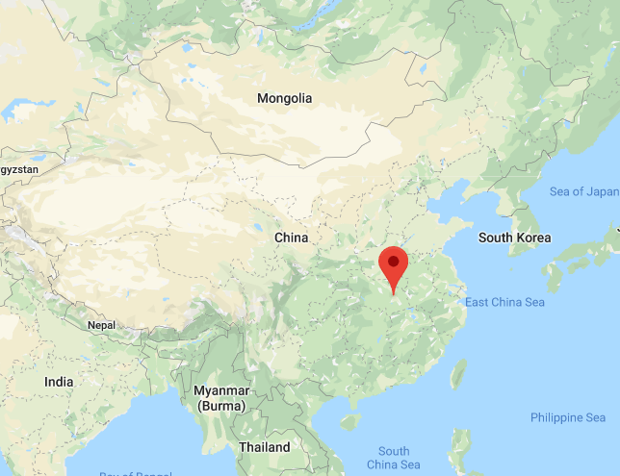

2019 n-CoV: Origin
First officially confirmed case on Dec 08, 2019 in Wuhan City, China
An outbreak of pneumonia of unknown etiology in Wuhan City was initially reported to WHO on December 31, 2019
Many of the initial confirmed cases are associated with a local seafood and animal market, but the source of the virus is still not clear: snake(likely), bat(maybe)
Wuhan City is currently locked down (population of 11MM; NY 9MM)

Slide 5
2019 n-CoV: US
The Centers for Disease Control and Prevention (CDC) confirmed the first case of 2019-nCoV in the United States in the state of Washington on Jan 21, 2020. The patient recently returned from Wuhan, China
On January 17, 2020, CDC began implementing public health entry screening at San Francisco (SFO), New York (JFK), and Los Angeles (LAX) airports. This week CDC added entry health screening at two more airports – Atlanta (ATL) and Chicago (ORD)

Slide 6
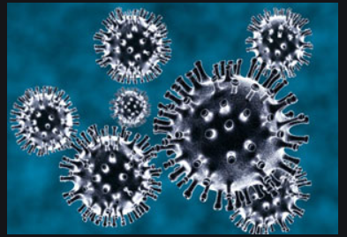
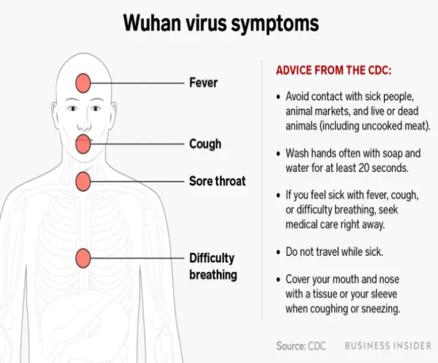
2019 n-CoV: the virus and disease
Coronaviruses are a large family of viruses whose effects range from causing the common cold to triggering much more serious diseases, such as severe acute respiratory syndrome (SARS). The name is due to their crown-like structure
Symptoms: Symptoms of 2019-nCoV are similar to a range of other illnesses such as influenza, include fever, coughing and difficulty breathing.
Treatment: currently no effective medicine or vaccine. Mainly early supportive therapy, management of Hypoxemic respiratory failure and septic shock

Slide 7
2019 n-CoV: Protection (WHO)
Frequently clean hands by using alcohol-based hand rub or soap and water;
When coughing and sneezing cover mouth and nose with flexed elbow or tissue – throw tissue away immediately and wash hands;
Avoid close contact with anyone who has fever and cough;
If you have fever, cough and difficulty breathing seek medical care early and share previous travel history with your health care provider;
When visiting live markets in areas currently experiencing cases of novel coronavirus, avoid direct unprotected contact with live animals and surfaces in contact with animals;
The consumption of raw or undercooked animal products should be avoided. Raw meat, milk or animal organs should be handled with care, to avoid cross-contamination with uncooked foods, as per good food safety practices.

Slide 8
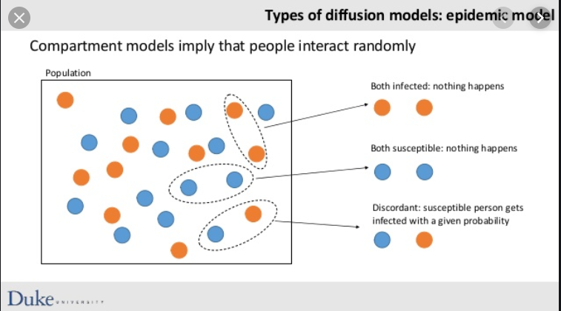
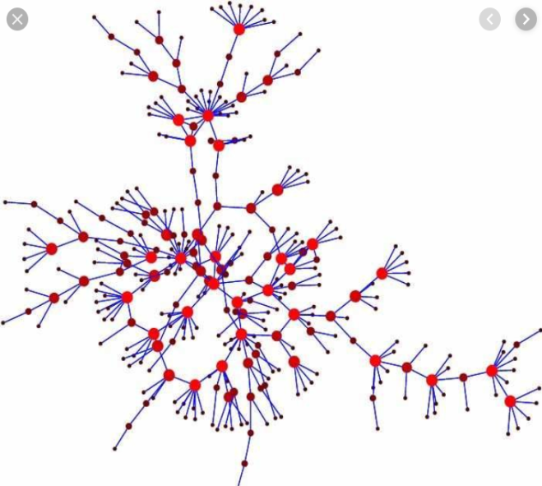
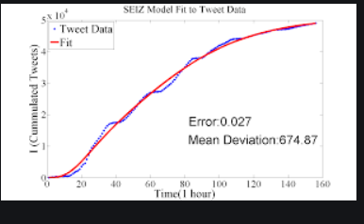
Epidemic Diffusion Model
Epidemic diffusion models are used in health research, information diffusion, technology diffusion, marketing, etc.…
Liu and Xiao, Modeling and Analysis of Epidemic Diffusion within Small-World Network, Journal of Applied Mathematics, 2010
Jin, Dougherty, etc…, Epidemiological Modeling of News and Rumors on Twitter, The 7th SNA-KDD Workshop ’13, 2013

Slide 9
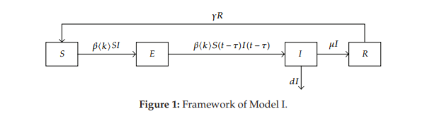
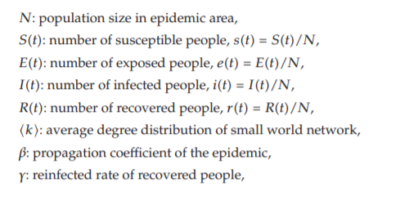

Epidemic Diffusion Model: SEIR
Model Framework
Liu and Xiao, Modeling and Analysis of Epidemic Diffusion within Small-World Network, Journal of Applied Mathematics, 2010

Slide 10
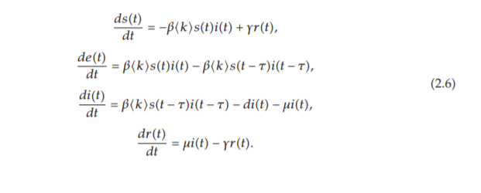
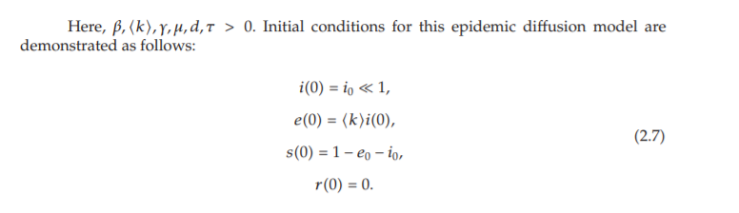
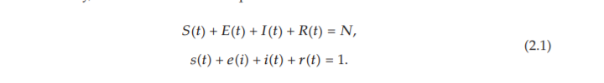
Epidemic Diffusion Model: An Example
The Model, with some work, the model can be written as a system of ODEs:
Note also

Slide 11
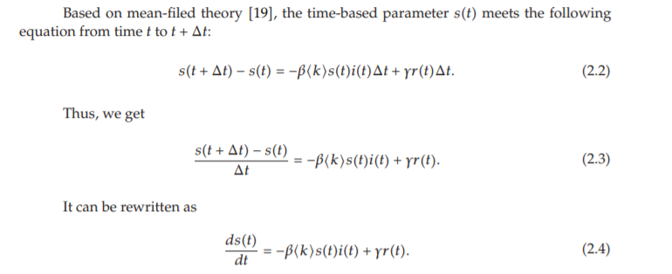
Epidemic Diffusion Model: An Example
For example, first equation in (2.6)

Slide 12
Epidemic Diffusion Model: An Example
For example, first equation in (2.6)

Slide 13


Epidemic Diffusion Model: An Example
Analysis – Two Stable Equilibria

Slide 14
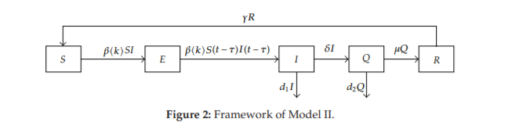
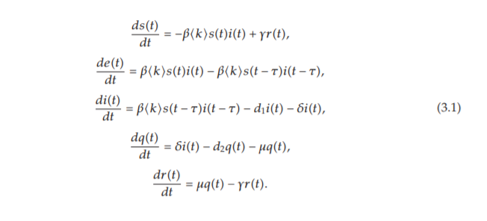
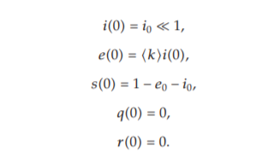
Epidemic Diffusion Model: SEIQR
Framework
Model
With initial conditions:

Slide 15


Epidemic Diffusion Model: SEIQR
Analysis – Two Stable Equilibria

Slide 16
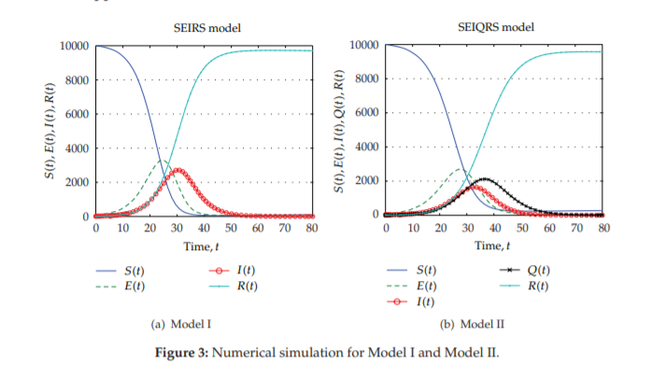
Epidemic Diffusion Model: Numerical Solution
Lower #infected due to quarantine

Slide 17
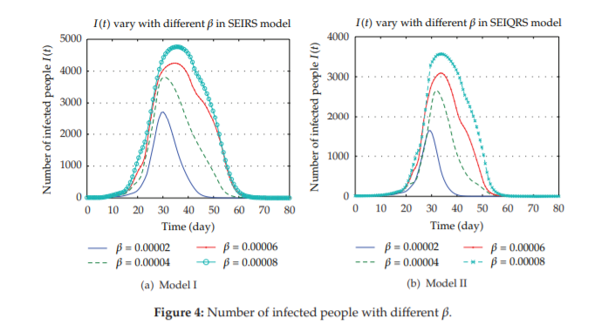
Epidemic Diffusion Model: Numerical Solution
Lower # infected due to quarantine for different propagation coefficients

Slide 18
Questions and Comments
Thank you!

